Slide 1

Food Nutrient Analysis
Tharinika S – 22BCS130
Samyuktha CS – 22BCS108
Shamiha S – 22BCS116

Slide 2
Domain – food technology and food chemistry
Food Technology and Food Chemistry are interdisciplinary fields that focus on the composition, processing, preservation, and quality of food.
Food Chemistry studies the chemical composition and reactions of food components, including:
Carbohydrates, Proteins, Fats – Their structure, function, and impact on nutrition.
Vitamins & Minerals – Essential micronutrients for human health.
Enzymes & Additives – Used in food preservation, fermentation, and flavor enhancement.
Food Processing Effects – How heat, moisture, and storage alter nutrients and flavor.
Food Technology applies scientific and engineering principles to develop and improve food products, including:
Food Preservation – Techniques like refrigeration, dehydration, and pasteurization.
Nutritional Enhancement – Fortification of food with essential vitamins and minerals.
Food Safety & Quality Control – Ensuring food is free from contaminants and meets health standards.
Innovative Processing Methods – Such as freeze-drying, extrusion, and fermentation

Slide 3
Problem statement
When food is harvested, it contains a certain amount of nutrients such as carbohydrates, proteins, vitamins, and minerals. However, these nutrients degrade or change due to various factors, including:
Cooking Methods:
Different cooking methods impact the nutrient content of food in various ways:
Boiling, Steaming, and Frying in Different Appliances
1️⃣ Oven Cooking:
Boiling (180°C) – Retains most macronutrients but may cause loss of water-soluble vitamins (e.g., Vitamin C).
Steaming (78°C) – Helps retain nutrients better than boiling, especially for delicate vegetables.
Frying (204°C) – Leads to nutrient loss due to high temperatures and oxidation but enhances fat absorption.
2️⃣ Air Fryer Cooking:
Boiling (160°C) – A gentler method, preserving more vitamins than traditional boiling.
Steaming (77°C) – Maintains moisture and reduces vitamin loss.
Frying (190°C) – Uses less oil than deep frying, making it a healthier alternative.

Slide 4
3️⃣ Stove Cooking:
Boiling (90°C) – Causes nutrient leaching into the water, especially for water-soluble vitamins.
Steaming (80°C) – Retains more nutrients than boiling while maintaining texture.
Frying (175°C) – High temperatures can destroy heat-sensitive vitamins but enhance flavor.
🔹 Environmental Factors:
Temperature – Heat accelerates nutrient degradation.
Humidity – Can lead to microbial growth and nutrient breakdown.
Oxygen Exposure – Causes oxidation, leading to loss of vitamins (e.g., Vitamin C )

Slide 5
Literature survey

Slide 6
Category | Details
Study | This study evaluated the effect of different cooking methods, including blanching, boiling, microwaving, and steaming, on the content of vitamins in vegetables. True retention was estimated using the yield expressed as a ratio of the weight of the cooked sample to the weight of the raw sample. The retention of vitamin C ranged from 0.0% to 91.1% for all cooked samples. Higher retention of vitamin C was observed after microwaving, while boiling resulted in the lowest retention. Cooked vegetables occasionally had higher contents of fat-soluble vitamins, including α-tocopherol and β-carotene, than their fresh counterparts, depending on the type of vegetable.
Methodology Used | All analysis methods were validated by determining precision (repeatability and reproducibility) and accuracy (recovery). Precision was defined as the coefficient of variation (CV), with at least five repetitions. Recovery was calculated using the formula: R% = [(Cs − Cp)/Ca] × 100, where: - R (%) = Recovery of added standard - Cs = Vitamin content in spiked sample - Cp = Vitamin content in sample - Ca = Vitamin added
Statistical Analysis | One-way analysis of variance (ANOVA) was performed using SAS version 9.4 (SAS Institute, Cary, USA). Results were compared using Duncan’s test with a significance level of p < 0.05.
Authors | Lee S, Choi Y, Jeong HS, Lee J, Sung J
Publication | Title: Effect of different cooking methods on the content of vitamins and true retention in selected vegetables Journal: Food Sci Biotechnol Date: December 12, 2017 Volume & Issue: 27(2):333-342 DOI: 10.1007/s10068-017-0281-1 PMID: 30263756 PMCID: PMC6049644

Slide 7
Category | Details
Study Objective | This work aimed to evaluate iron and zinc retention in six common bean (Phaseolus vulgaris L.) cultivars under different cooking conditions: raw beans, regular pot cooking, pressure cooking (with and without previous water soaking), and broth.
Design | Determination of iron and zinc content in raw beans, cooked bean grains, and broth samples was conducted using Inductively Coupled Plasma (ICP) Optical Emission Spectrometry (Spectro Analytical Instrument - Spectroflame P).
Data Mining Method | Statistical Analysis & Pattern Recognition – The study uses statistical techniques to analyze nutrient retention patterns and determine the effect of different cooking methods on iron and zinc content.
Authors | Carvalho L. M., Corrêa M. M., Pereira E. J., Nutti M. R., Carvalho J. L. V., Ribeiro E. M., & Freitas S. C.
Publication | Title: Iron and zinc retention in common beans (Phaseolus vulgaris L.) after home cooking Journal: Food & Nutrition Research DOI: 10.3402/fnr.v56i0.15618

Slide 8
Study | Application of K-Means Clustering in Nutrient Retention Analysis
Authors | Rosmahadi, N. A. S., & Hamdan, M. H. (2022)
Published In | Proceedings of Science and Mathematics, Volume 8, Pages 159-169
Methodology | Cluster Analysis Steps
 | a) Obtain the data matrix.
 | c) Compute the resemblance matrix.
 | e) Rearrange the data and resemblance matrices.
 | K-Means Clustering Process
 | a) Initialization: Choose number of clusters (K) and place K centroids.
 | b) Cluster Update: Assign each entity to the nearest centroid using the minimum distance rule.
 | c) Centroid Update: Compute new cluster centroids based on assigned data points.
 | d) Halting Test: If centroids remain unchanged, stop; otherwise, repeat steps.
 | Challenges of K-Means Clustering
 | - Sensitivity to the initial number of clusters (K) and centroid positions.
 | - Instability of clustering results based on different initialization settings.
 | - Lack of interpretation aids for understanding clustering outputs.
Key Nutritional Factors Considered | Calories
Scientific Definition of Calorie | The amount of heat required to raise the temperature of 1g of water by 1°C (~4.19 joules).
Source | Rosmahadi & Hamdan (2022) - Proc. Sci. Math. 8:159-169

Slide 9
Flow chart

Slide 10
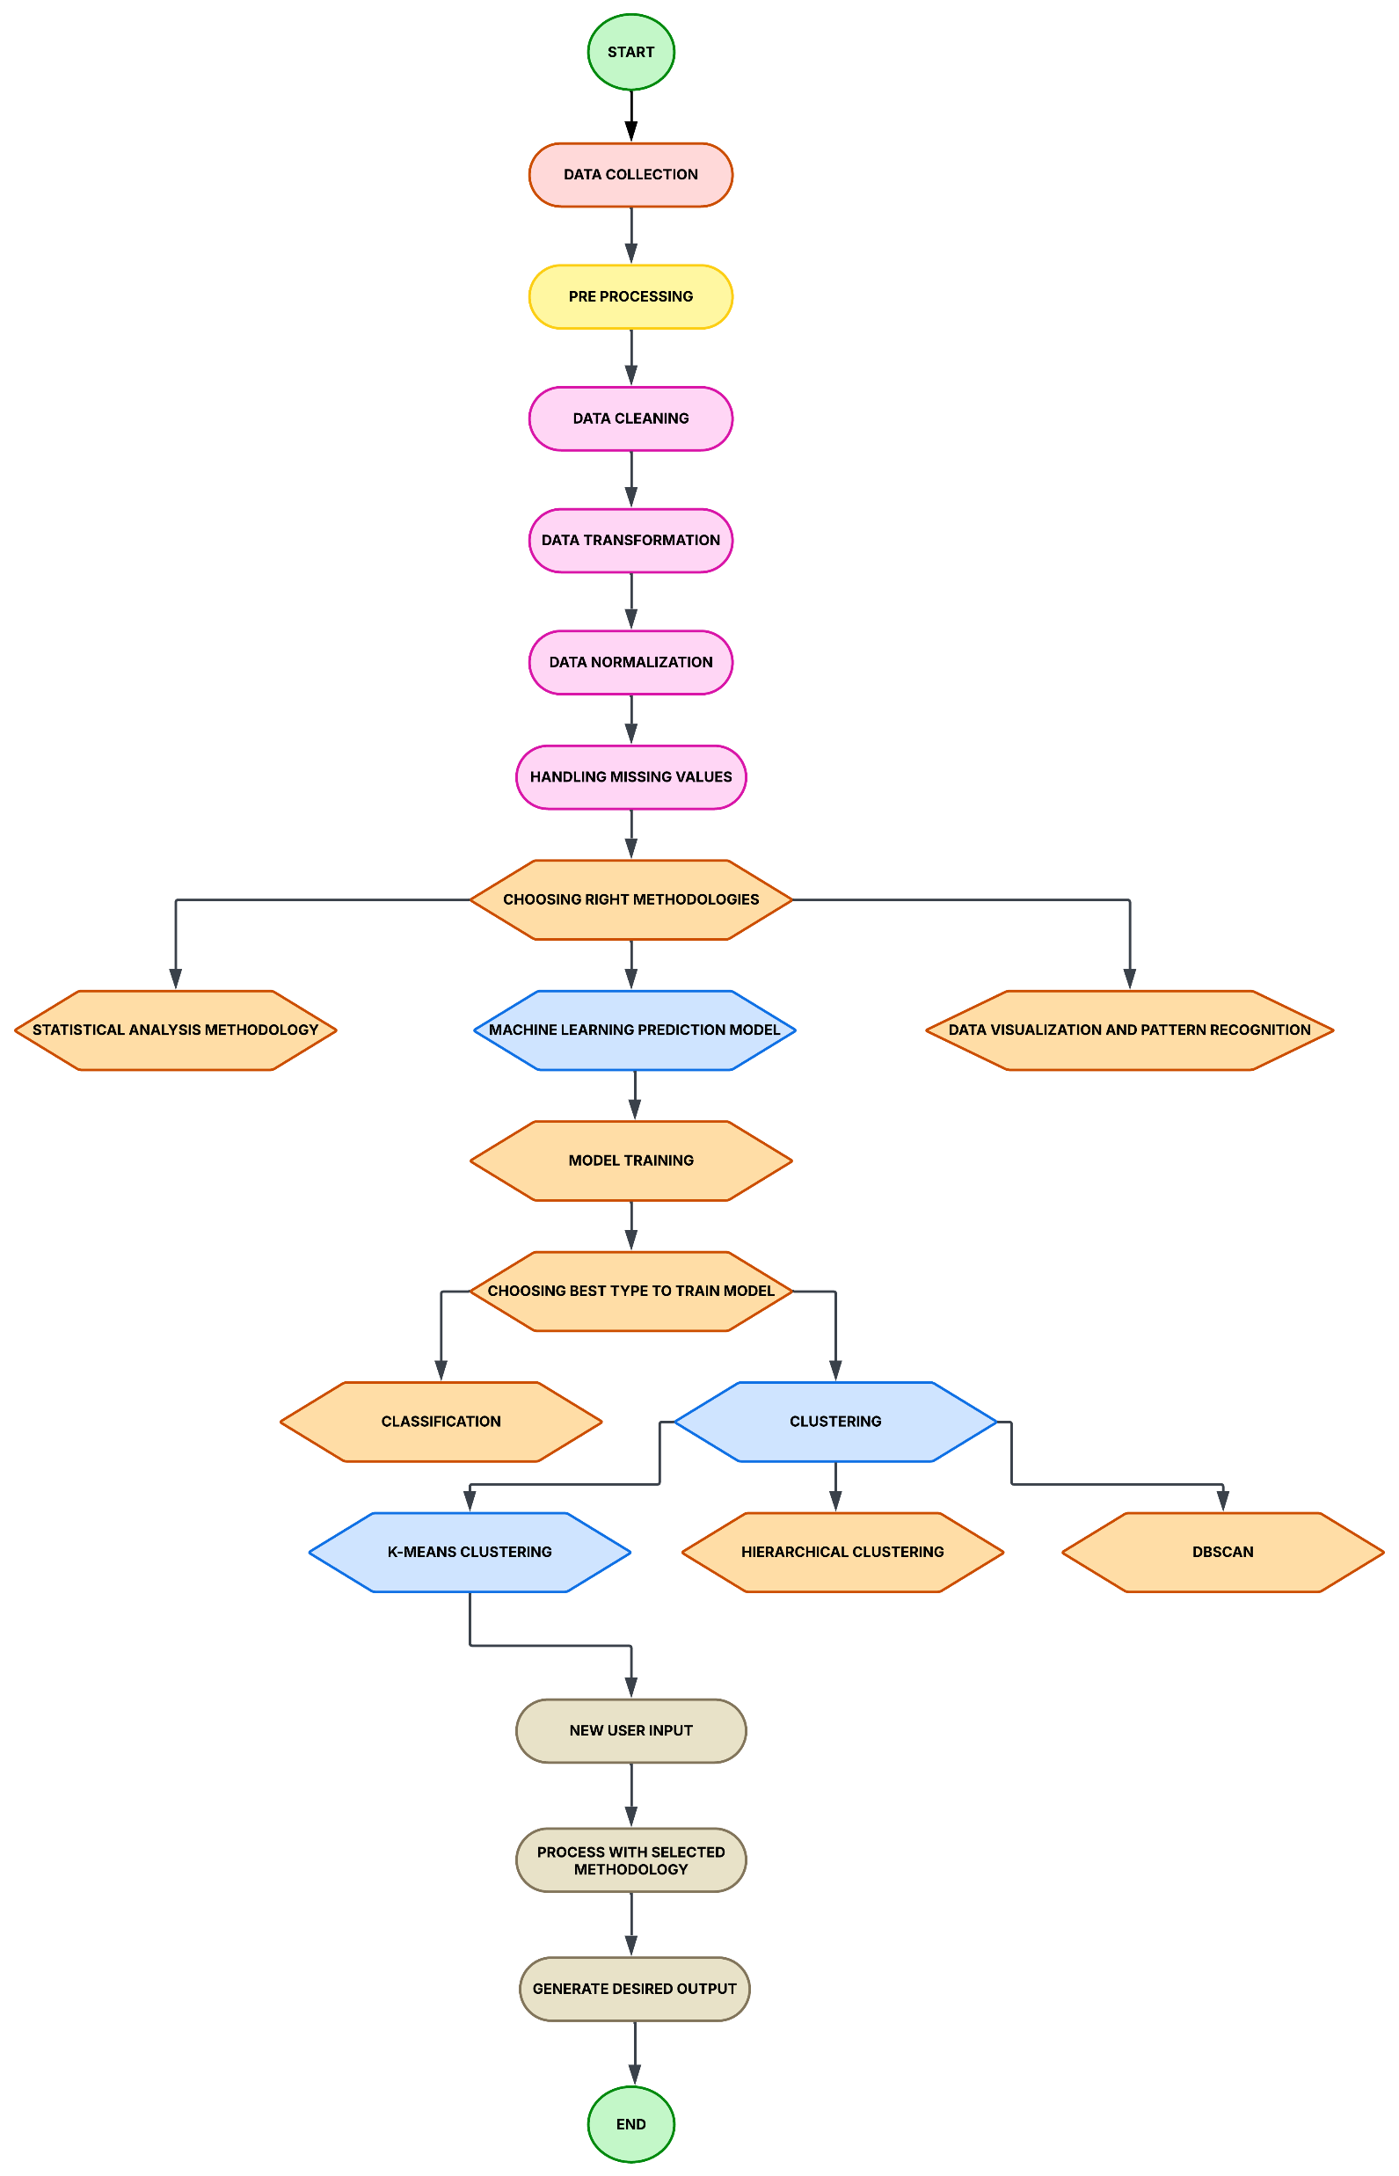

Slide 11
Data collection

Slide 12
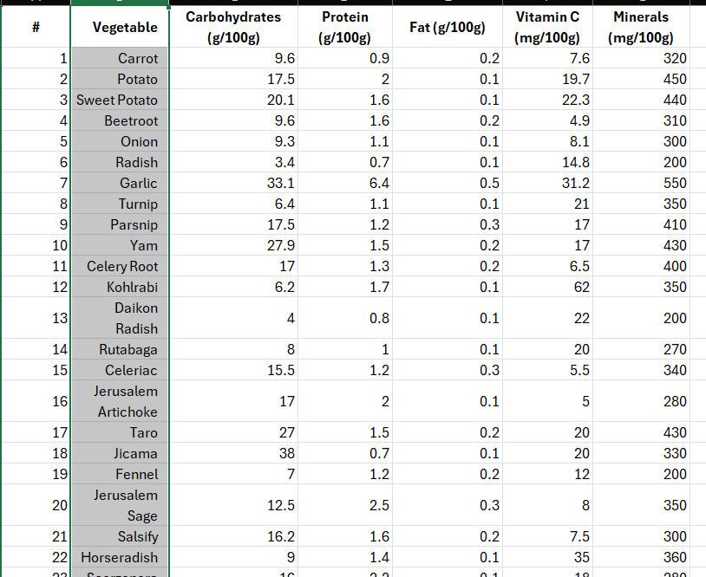
Dataset 1 :

Slide 13
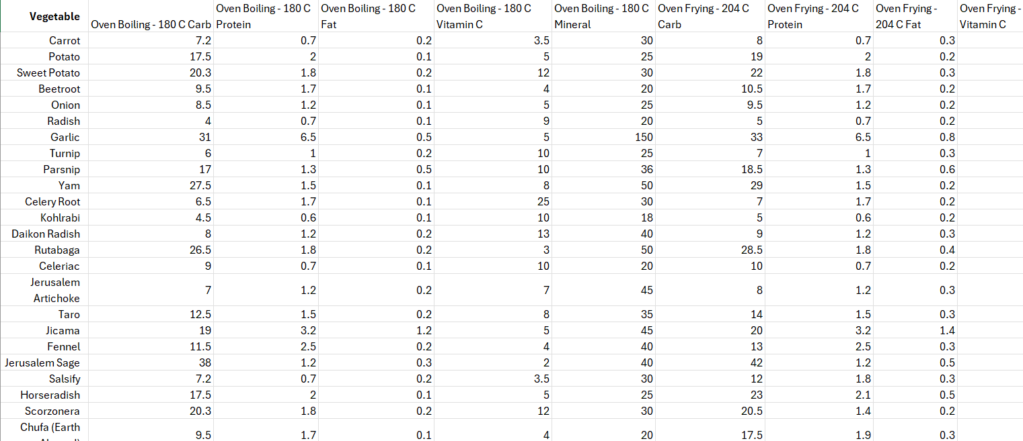
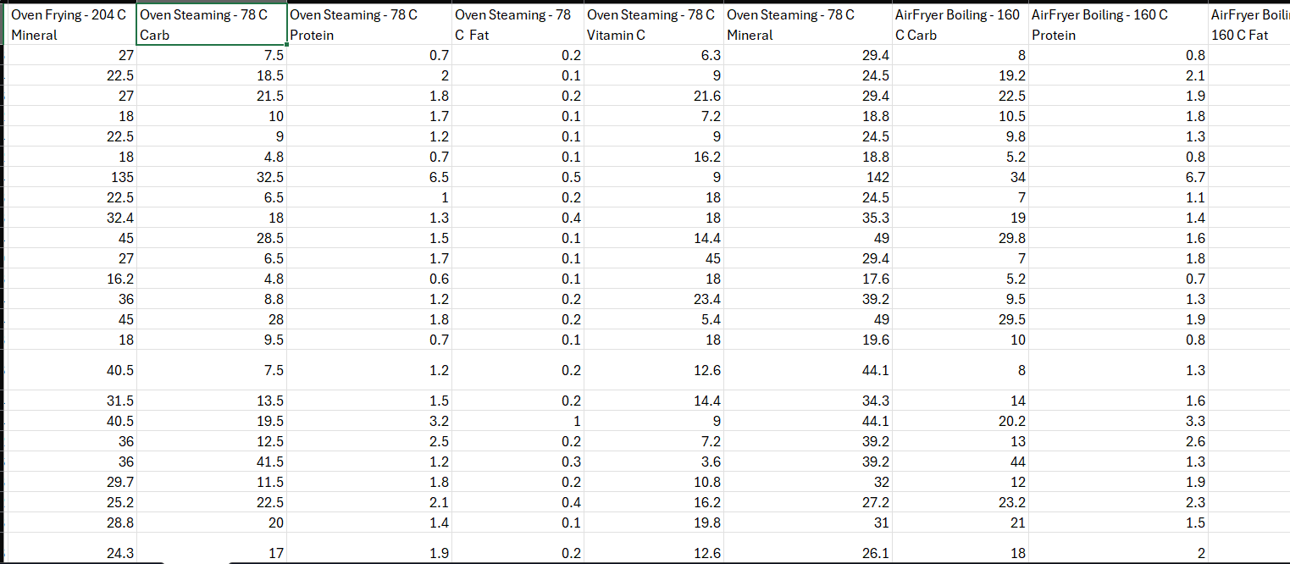
Dataset 2 :

Slide 14
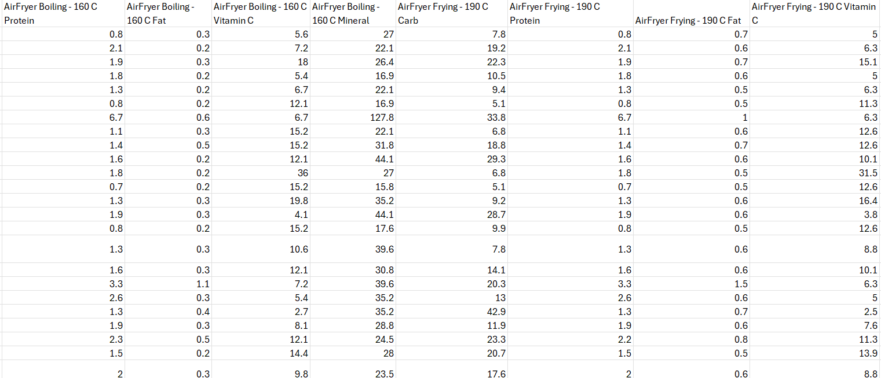
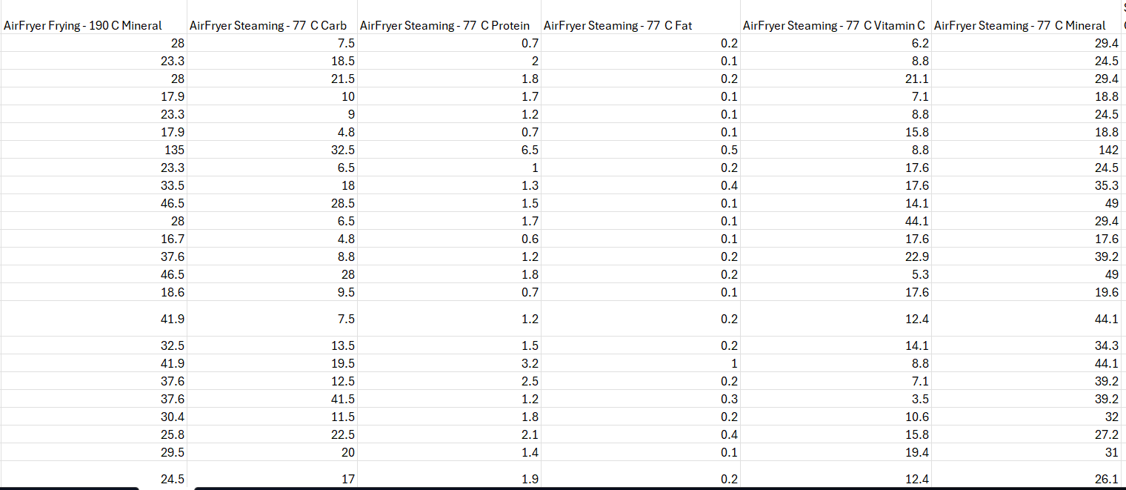
Dataset 2 : (continue)

Slide 15
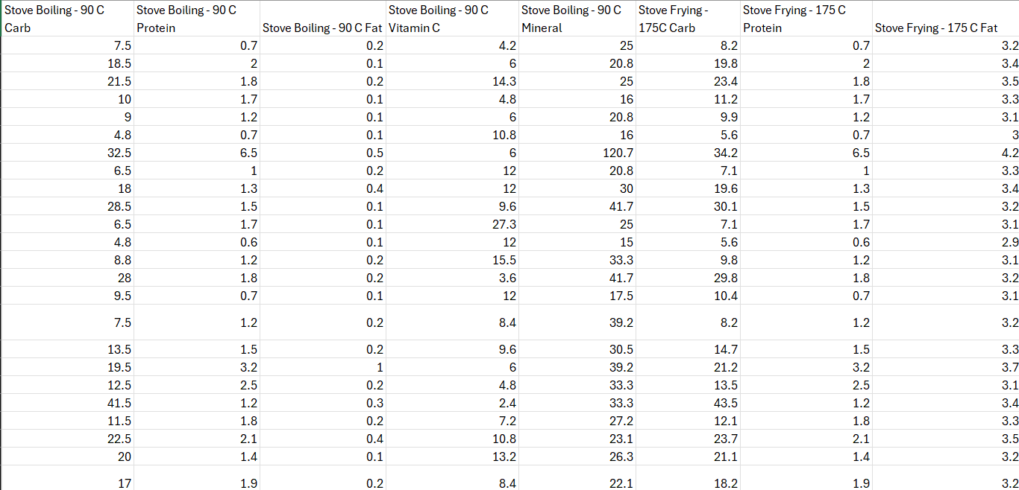
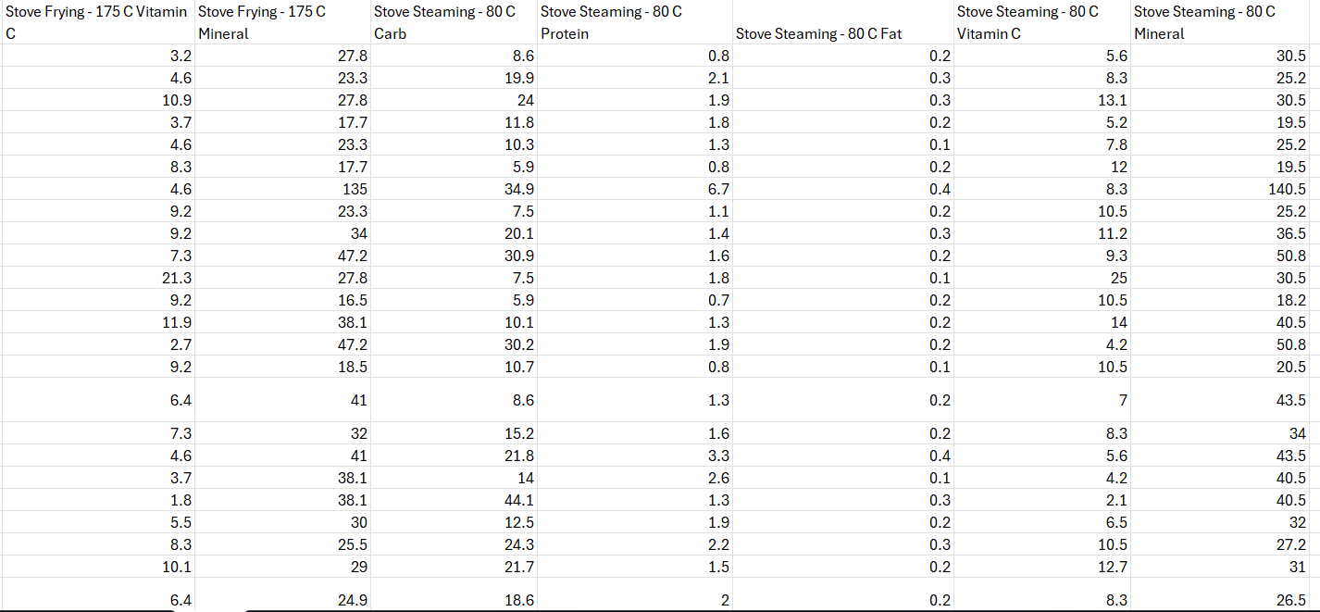
Dataset 2 : (continue)

Slide 16
Data preprocessing

Slide 17
Data preprocessing is a crucial step in ensuring that the collected nutrient data is accurate, clean, and structured for analysis.
It involves the following steps:
1. Data Cleaning
Removing errors, duplicates, or inconsistencies in the dataset.
Handling missing values using techniques such as:
Mean/Median Imputation: Filling gaps with the average or median values.
Interpolation: Estimating missing values based on trends.
Deleting Irrelevant Data: Removing unrelated or incorrect data points.
2. Data Integration ( combining multiple sheets)
Sheet1 and Sheet2 contain relevant data, so they will be merged during clustering
3. Data Transformation
Converting raw values into percentage changes to analyze nutrient retention or loss.
Standardizing/normalaization nutrient units (e.g., mg per 100g of vegetable).
The "Vegetable" column is categorical; encoding (One-Hot Encoding)
Log transformations if data is skewed.

Slide 18
Choosing methodologies

Slide 19
After preprocessing, the next step is to choose the appropriate method for analyzing how nutrients change during harvesting and different cooking methods (boiling, frying, steaming).
1. Statistical Analysis Methodology
Used to determine significant changes in nutrient content before and after cooking.
Common techniques:
ANOVA (Analysis of Variance): Compares nutrient differences across multiple cooking methods.
T-tests: Compares nutrient content before and after cooking for each method.
Regression Analysis: Predicts nutrient loss trends based on cooking time and temperature.
2. Machine Learning Prediction Model
If a predictive approach is needed, machine learning can help estimate nutrient retention.
Supervised Learning: Predicts nutrient retention based on past data.
Unsupervised Learning (Clustering): Groups vegetables based on their nutrient stability.
3. Data Visualization & Pattern Recognition
Helps identify patterns in nutrient changes across different vegetables and cooking methods.
Visual tools:
Heatmaps: Show which cooking methods cause the highest nutrient loss.
Line charts: Track nutrient changes over time.

Slide 20
Why we chose this method ? – Machine Learning Prediction Model

Slide 21
We chose the Machine Learning Prediction Model over traditional statistical methods because:
Predicting Future Nutrient Trends
Unlike traditional statistical analysis, machine learning can predict nutrient retention or loss in new vegetables based on historical data.
Helps estimate nutrient changes even when real lab testing is unavailable.
2. Handling Large & Complex Datasets
Traditional methods struggle with large datasets containing multiple variables (e.g., cooking temperature, time, vegetable type).
Machine learning efficiently finds hidden patterns and correlations.
3. More Accurate and Adaptive
ML models improve with more data, unlike static statistical tests.
Can adapt to new vegetables, different cooking conditions, and regional variations.4. Clustering Similar Vegetables
Helps group vegetables based on their nutrient stability (e.g., root vegetables vs. leafy vegetables).
Example: Carrots and radishes may have similar Vitamin C retention patterns.
5. Real-Time Data Processing
ML models can analyze new input data instantly, making them useful for dietitians, food scientists, and consumers

Slide 22
Model : Neural Network-Based Prediction of Nutrient Change

Slide 23
Once we choose machine learning as the best approach, we need to train a neural network model to accurately predict nutrient changes after cooking.
1. Data Preparation for Training
Split the dataset into:
Training Set (70-80%): Used to train the neural network.
Testing Set (20-30%): Used to evaluate model accuracy.
Features (Inputs):
Vegetable type (e.g., potato, carrot, radish).
Cooking method (boiling, frying, steaming).
Cooking temperature.
Target (Output):
Nutrient retention (%) for carbohydrates, protein, fat, Vitamin C, and minerals.
2. Choosing a Machine Learning Algorithm
A neural network is used for predicting nutrient retention based on cooking parameters.
Unsupervised Learning (Clustering) is applied to group vegetables based on nutrient stability.
3. Training the Model
The neural network learns patterns from past nutrient data.
Model parameters (e.g., learning rate, number of layers, activation functions) are adjusted to minimize error.
4. Evaluating Model Performance
Compare model predictions with actual nutrient values.
Metric used:
Mean Absolute Error (MAE): Measures the average difference between predicted and actual nutrient retention values.

Slide 24
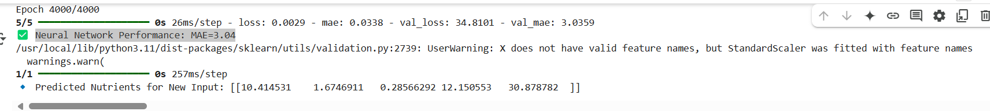

Slide 25
Why We Chose Clustering Over Classification in Nutrient Analysis

Slide 26
In our nutrient analysis, we chose clustering instead of classification because:
Clustering Finds Hidden Patterns
Classification requires predefined labels (high, medium, low nutrient loss).
Clustering automatically groups vegetables based on similar nutrient retention, even if labels are unknown.
Helps identify new patterns in how cooking affects nutrients.
2. No Need for Labeled Data
Classification requires labeled data, which is often time-consuming to collect.
Clustering works without predefined categories, making it more flexible.
3. Better for Grouping Vegetables
Some vegetables behave similarly when cooked (e.g., potatoes and sweet potatoes may have similar carb retention).
Clustering can group them together based on nutrient loss trends.
4. Helps with Food Recommendations
If a user wants to know which vegetables retain the most nutrients after boiling, clustering can group the best options together.
Useful for dietitians and researchers.
5. Clustering Methods Used
K-Means Clustering: Groups vegetables into clusters based on nutrient loss similarity.
Hierarchical Clustering: Creates a tree-like structure showing how different vegetables relate.

Slide 27
Advantages of Using K-Means Clustering for Nutrient Retention Analysis

Slide 28
nutrient retention patterns after cooking.
K-Means is Simple and Scalable
Works well with large datasets of vegetables, nutrients, and cooking methods.
Faster than other clustering methods like Hierarchical Clustering.
2. Finds Meaningful Groups Automatically
Groups vegetables with similar nutrient loss patterns without needing predefined categories.
Example: Carrots and radishes may cluster together due to high Vitamin C loss during boiling.
3. Handles Continuous Nutrient Data Well
Unlike DBSCAN, which is better for outlier detection, K-Means works well for structured numerical data like nutrient percentages.
4. Flexibility in Choosing the Number of Clusters (K)
We can set the number of clusters based on:
Nutrient retention levels (e.g., high, medium, low).
Types of vegetables with similar cooking responses.
5. Helps with Decision-Making
Can be used for dietary recommendations by identifying the best vegetables for nutrient retention.

Slide 29
Step-by-Step Process of K-Means Clustering for Nutrient Retention Analysis

Slide 30
Step 1: Choose the Number of Clusters (K)
The elbow method suggests K = 4, meaning we group vegetables into four clusters based on nutrient retention.
Step 2: Initialize Cluster Centers (Centroids)
Randomly select 4 initial centroids in the dataset.
Each centroid represents the center of a nutrient retention group.
Step 3: Assign Vegetables to the Nearest Centroid
Compute the Euclidean distance between each vegetable’s nutrient data and the centroids.
Assign each vegetable to the closest centroid (cluster).
Step 4: Update Centroids
Recalculate the mean nutrient values of all vegetables in each cluster.
Move the centroid to this new average position.
Step 5: Repeat Until Clusters Stabilize
Steps 3 and 4 are repeated until the centroids stop changing (convergence is reached).
This ensures vegetables are correctly grouped based on nutrient retention.
Step 6: Interpret the Results
Identify the meaning of each cluster:
Cluster 1: Very high nutrient retention (best for steaming).
Cluster 2: High retention (best for minimal water cooking).
Cluster 3: Medium retention (better for boiling).
Cluster 4: Low retention (nutrients lost significantly in frying).

Slide 31
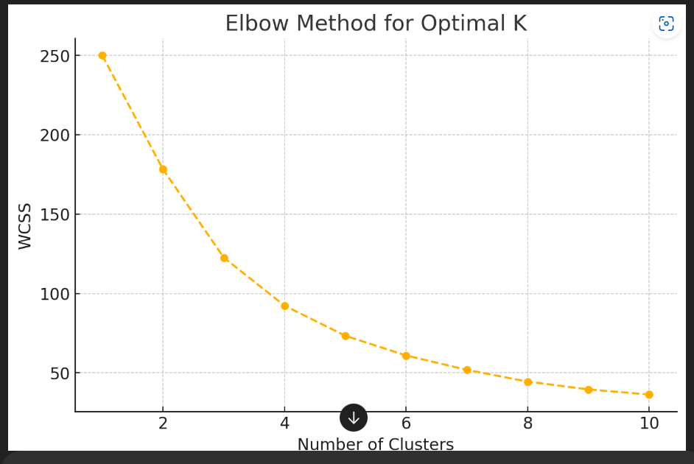
Output of k means of nutrition datasets

Slide 32
References
Nibret Mekonen, Henok Nahusenay, Kidist Hailu. (2022). Effect of Processing Methods on Nutrient Contents of Sweet Potato (Ipomoea batatas (L.) Lam.) Varieties Grown in Ethiopia. Journal of Food and Nutrition Sciences, 10(2), 36-41. https://doi.org/10.11648/j.jfns.20221002.11
@inproceedings{10.1145/3570236.3570254,author = {Shi, Li and Pan, Liangming},title = {Food Nutrient Composition Analysis Based on Adaptive AP Clustering Algorithm},year = {2023},isbn = {9781450396714},publisher = {Association for Computing Machinery},address = {New York, NY, USA},url = {https://doi.org/10.1145/3570236.3570254},doi = {10.1145/3570236.3570254}
Burg, P., & Fraile, P. (1995). Vitamin C destruction during the cooking of a potato dish. LWT-Food Science and Technology, 28(5), 506-514.
The effects of pre-harvest and post-harvest factors on the nutritional quality of strawberry fruits Authors: Alvarez-Suarez, Josè M.^{a; b} | Mazzoni, Luca^{b} | Forbes-Hernandez, Tamara Y.^{b} | Gasparrini, Massimiliano^{b} | Sabbadini, Silviaª | Giampieri, Francescaa https://content.iospress.com/articles/journal-of-berry-research/jbr068
Zhu, J.; Wang, G. Artificial Intelligence Technology for Food Nutrition. Nutrients 2023, 15, 4562. https://doi.org/10.3390/nu15214562
Zhidong Shen, Adnan Shehzad, Si Chen, Hui Sun, Jin Liu,
Machine Learning Based Approach on Food Recognition and Nutrition Estimation,
ISSN 1877-0509,
https://doi.org/10.1016/j.procs.2020.06.113.
(https://www.sciencedirect.com/science/article/pii/S1877050920316331)

